Slide 1

D. Serikbayev East Kazakhstan state technical university
Faculty of Earth Sciences
Sub-department “The Safety of Human Life and Protection of Environment”
«Risk analysis methodological support. Risk acceptance criteria»
Lecturer: Daumova G.K.

Slide 2
Abstract
Risk analysis methodological support - this is set of methods, techniques and software tools that allow identification of hazards and assess the emergency situation risk, comprehensive. Industrial facility may be the source of this.

Slide 3
Methodological Tools for Risk Assessment in Industrial
Enterprises
Risk assessment is derivation analysis and risk scale analysis in the specific situation.
P = n/N – risk,
n –adverse danger of situations
N - possible number of situations
R(m) = 2 pm , risk degree,
p –damage related event occurrence probability
m – damage random amount

Slide 4
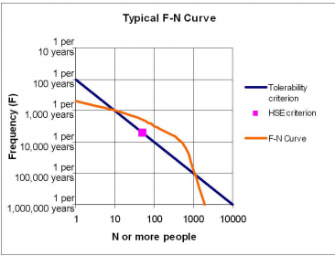
Types of risks
Individual risk - is the annual risk of death or serious injury
Social risk- relationship between the probability of a catastrophic incident, expressed as the average frequency with which it can be expected to occur, and its consequences. It is usually represented as an F-N curve.

Slide 5
Risk analysis
 | RISK
Threat | Property |  | Organism
Damage type | Quantifiable | Not quantifiable | Health | Death
Evaluation parameter | Expected value | limit exceeding probability | Probability estimation | Probability estimation

Slide 6
Analysis scheme
1. Planning and organization;
2. Hazards identification;
2.1. Hazards detection;
2.2. Hazards characteristics preliminary assessment;
3. Risk assessment;
3.1. Frequency analysis;
3.2. Consequences analysis;
3.3. Uncertainty analysis;
4. Risk management recommendations development.

Slide 7
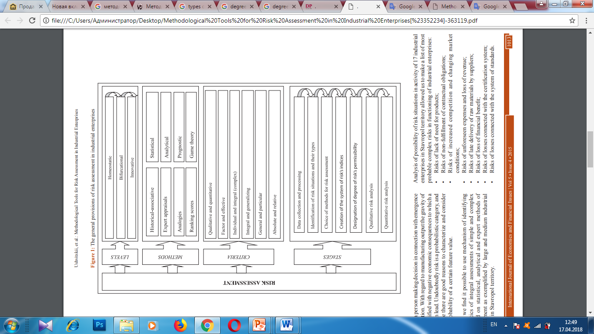
Risk assessment

Slide 8
Risk acceptance
An acceptable risk is the risk associated with the best of available alternatives, not with the best of alternatives which we would hope to have available

Slide 9
Risk acceptance criteria
Absolute safety concept is outdated !
Acceptability should be based on economic and social indicators.
Risk level from hazards is so low (low probability of damage), that is permissible to profits obtained.

Slide 10
Risk acceptance criteria
Factors that Determine Risk Acceptability
Personal
Political / Social
Economic

Slide 11
Method
Economic safety analysis method based on accounting costs for safeness and losses from possible accidents
object can be only relatively safe
level of security depends on the socio-economic state of society and formed on the acceptability basis
risk is determined by factors that affect safety and their quantification

Slide 12
5 Steps for Risk Acceptability Assessment
Define the alternatives
Specify the objectives and measures of effectiveness to indicate the degree to which they are achieved
Identify the possible consequences of each alternative
Quantify the values for the various consequences
Analyze the alternatives to
select the best choice

Slide 13
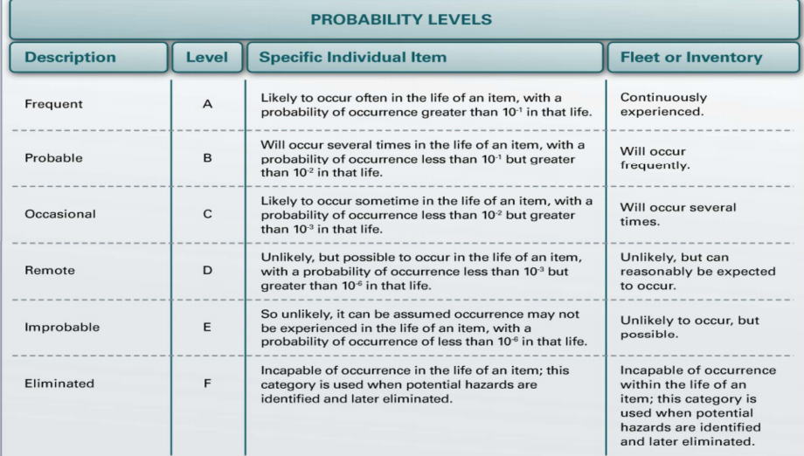

Slide 14
Thank you for attention!

